Slide 1
An Axiomatic Basis for Computer Programming
C. A. R. HOARE
1969
Presenter：Yuhan Li

Slide 2
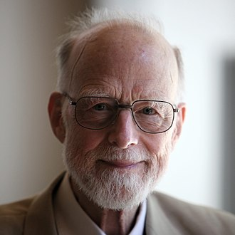
C. A. R. HOARE
Charles Antony Richard Hoare
（Tony Hoare）
Contributions：
Quicksort
Hoare logic
CSP(communicating sequential processes)
Null pointer
Awards：Turing awards(1980)

Slide 3

BACKGROUND
computer programming is an exact science
reason about programs deductively
sets of axioms and rules of inference

Slide 4
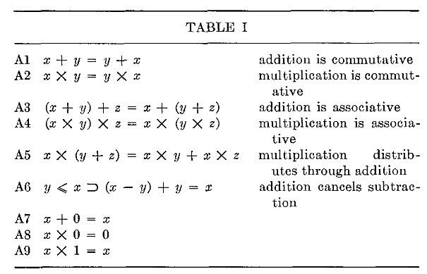
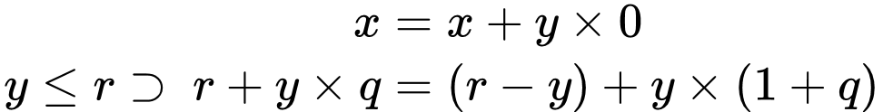
Computer Arithmetic

Slide 5
Computer Arithmetic
x + y = y + x
Sure…
x + 1 > x
…overflows?

Slide 6
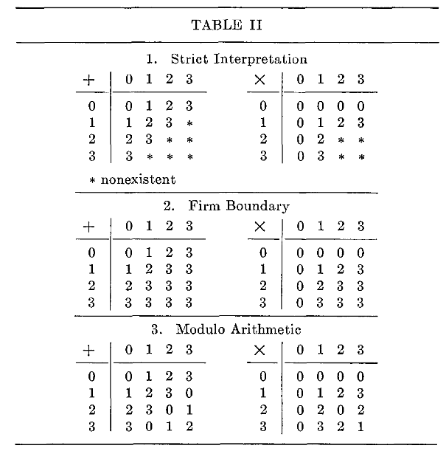
Computer Arithmetic

Slide 7
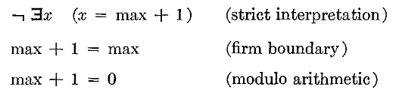
Computer Arithmetic
max + 1
Notes:
通过从一组互斥的补充公理中选择一个特定的公理而严格地相互区分

Slide 8
Program Execution
Main idea : define a notation to capture the relation
What we know before {P}
Program Q
What we know after {R}
If the assertion P is true before initiation of a program Q, then the assertion R will be true on its completion
Notes:
使用严格的数理逻辑推理来替计算机程序的正确性提供一组逻辑规则

Slide 9


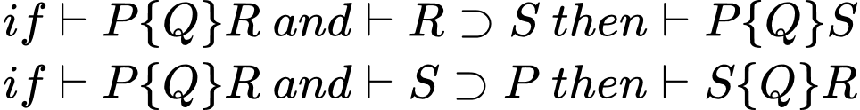
AXIOM
D0 Axiom of Assignment
D1 Rules of Consequence
D2 Rules of Composition
D3 Rules of Iteration

Slide 10




AXIOM
D0 Axiom of Assignment
D1 Rules of Consequence
D2 Rules of Composition
D3 Rules of Iteration
or
{true}

Slide 11
AXIOM
D0 Axiom of Assignment
D1 Rules of Consequence
D2 Rules of Composition
D3 Rules of Iteration
and
and

Slide 12
AXIOM
D0 Axiom of Assignment
D1 Rules of Consequence
D2 Rules of Composition
D3 Rules of Iteration

Slide 13
EXAMPLE
x ÷ y = q…r
This expresses a necessary (but not sufficient) condition for the "correctness" of the program.

Slide 14
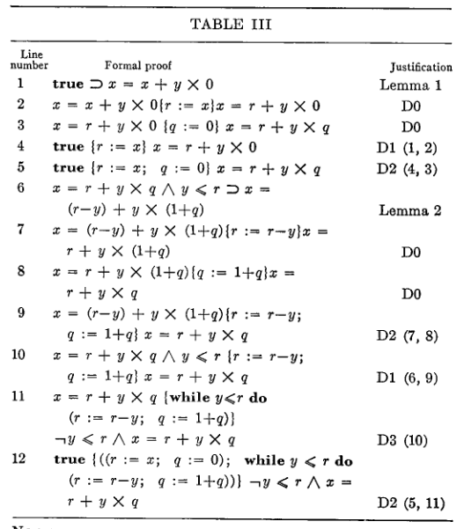
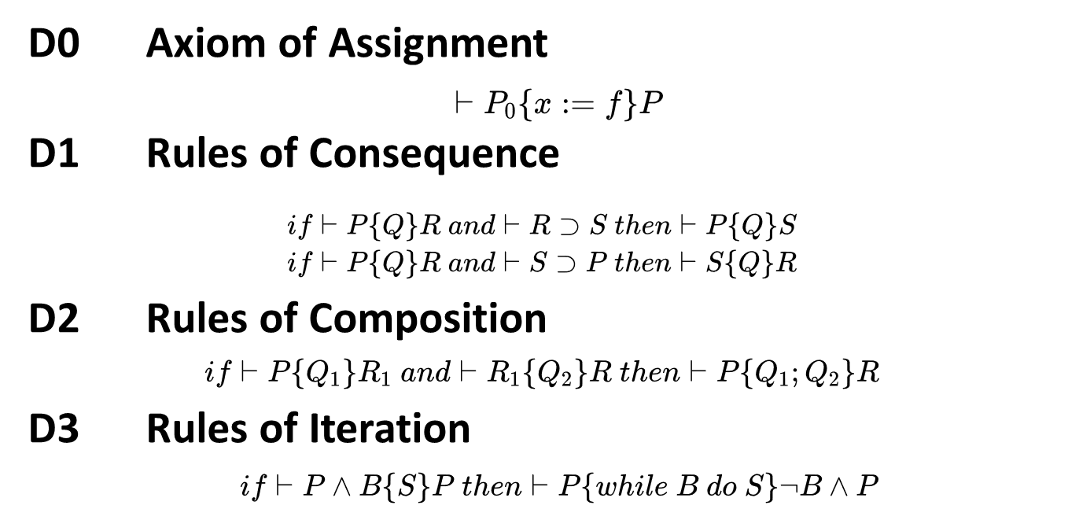
EXAMPLE

Slide 15
General Reservations
Drawbacks to the axiomatic based approach
Assume the absence of side effects
Do not prove that a program terminates
Partial correctness
Total correctness
Total correctness =partial correctness + termination

Slide 16
General Reservations
Drawbacks to the axiomatic based approach
Assume the absence of side effects
Do not prove that a program terminates
Some areas not covered
real arithmetic, bit and character manipulation, complex arithmetic, fractional arithmetic, arrays, records, overlay definition, files, input/ output, declarations, subroutines, parameters, recursion, and parallel execution
Some areas present difficulty
Labels, jumps, pointers

Slide 17




Proofs of Program Correctness
The practice of proving programs can alleviate other problems in the computing world
Program documentation
Reuse
transferring programs from one design of computer to another

Slide 18



Formal Language Definition
A programming language standard should consist of a set of axioms together with a choice from a set of supplementary axioms describing the range of choices facing an implementor.
Formal language definition is to assist in the design of better programming languages

Slide 19
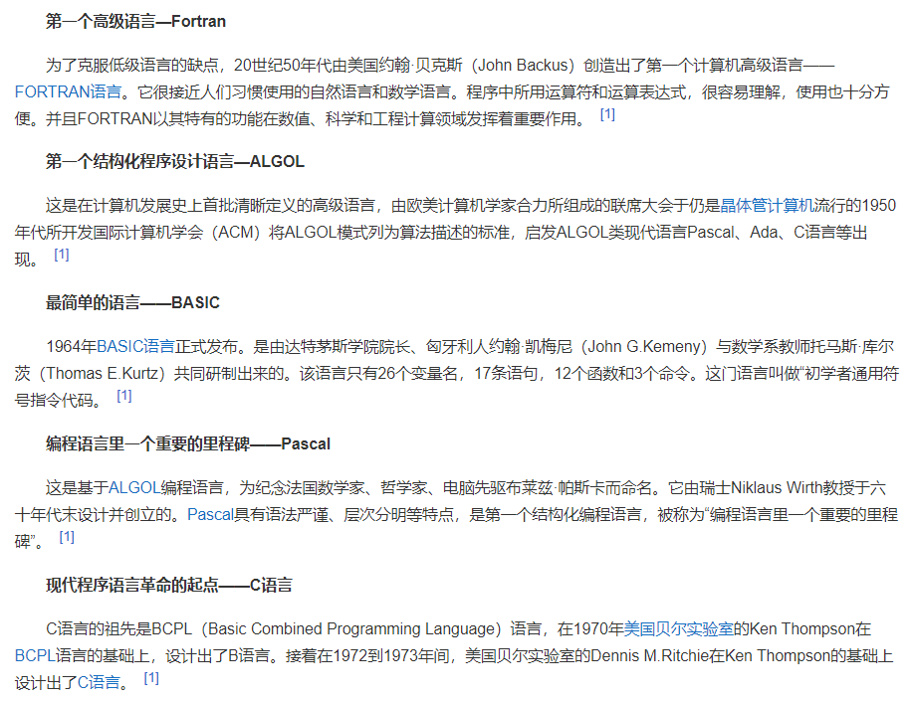

Slide 20
Thanks

